Slide 1
Introduction to Statistical Thinking

Slide 2
Statistical concept

Slide 3
What Is Statistics?
Statistics is the scientific method of collecting, organizing, summarizing and presentation of analytical findings from the raw data.
In other words, it is the study and manipulation of data, including ways to gather, review, analyze, and draw conclusions from data.
Statistics is a highly interdisciplinary field; research in statistics finds applicability in virtually all sectors such as banking, hospitals, etc.

Slide 4
Statisticians, people who do statistics, are particularly concerned with determining how to draw reliable conclusions about large groups from the small samples. These small samples represent a portion of the large group or a limited number of instances of a general phenomenon.

Slide 5
Population Data versus Sample Data
Population
A population is a complete set. Population data is a collection of all elements in the population. For example:
All the height of graduating students at the Eastern College Somalia
All the weight of females in Ethiopia
All the ages of students in South Sudan
All countries in Africa

Slide 6
Population Data versus Sample Data
If the desired information is available for all items in the population, we have what is referred to as a census. In practice, we rarely have a complete set of data. We usually collect data in samples, such as the weight of 10 female students in Ethiopia.

Slide 7
Population Data versus Sample Data
Sample
A sample is a subset or fraction of the population. For example:
150 fish randomly sampled from Adar River in South Sudan
5 best students selected from each University in Sudan
Taking 10 East African countries out of the 54 African countries

Slide 8
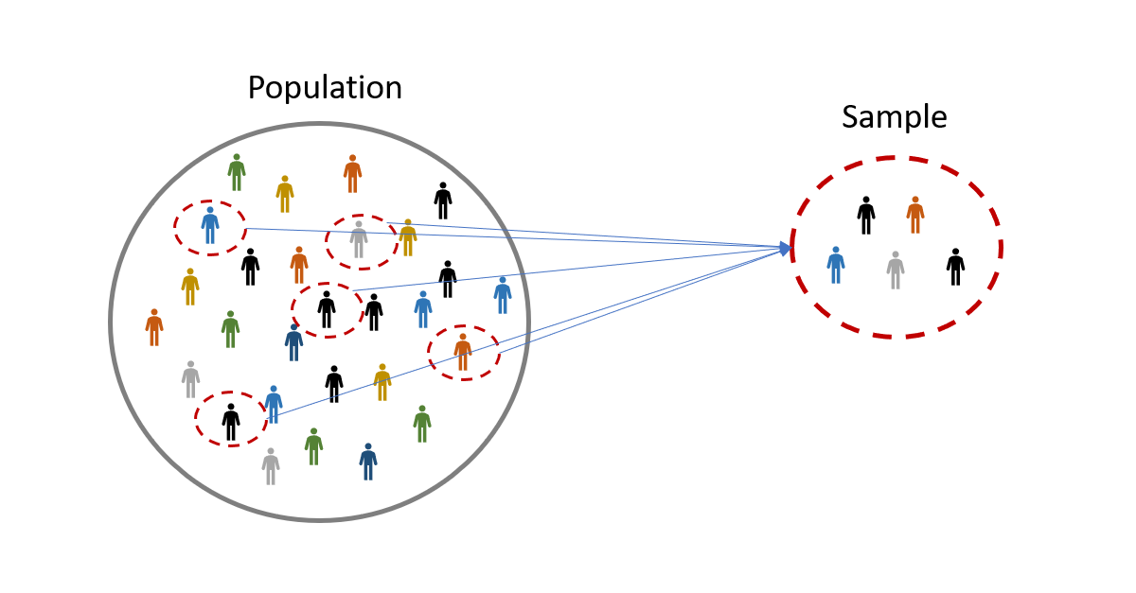
Population versus Sample
A pictorial difference between population and a sample

Slide 9
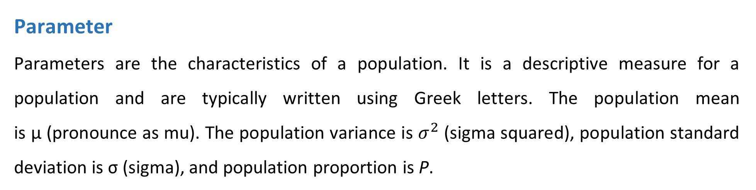
Parameters vs Statistics
Parameter
Parameters are the characteristics of a population. It is a descriptive measure for a population and are typically written using Greek letters. The population mean is μ (pronounce as mu). The population variance is $σ^{2}$ (sigma squared), population standard deviation is σ (sigma), and population proportion is P.

Slide 10
Parameters vs Statistics
Statistic
Statistic is the characteristics of a sample. It is a descriptive measure for a sample and are typically written using Roman letters. The sample mean is X ̅(x-bar), the sample variance is s2, the sample standard deviation is s, and the sample proportion is p. Sample statistics are used to estimate unknown population parameters.

Slide 11
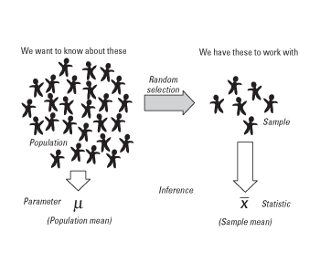
Parameters vs Statistics

Slide 12


